Slide 1

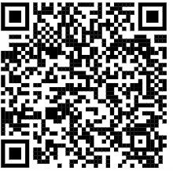

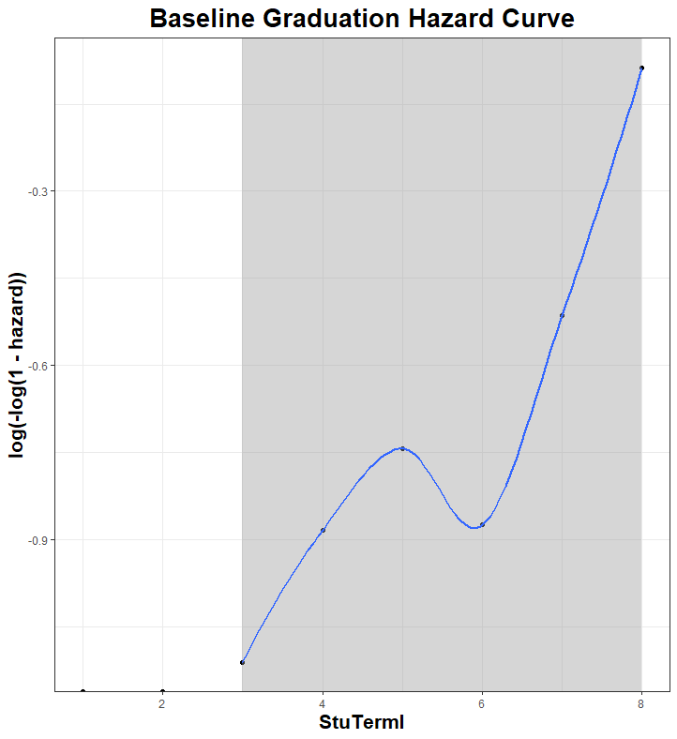
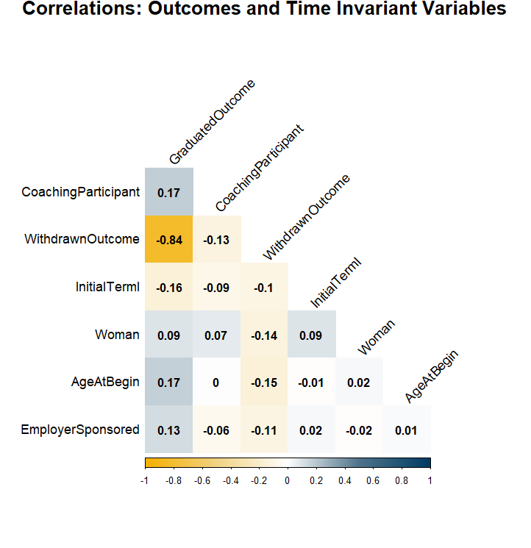
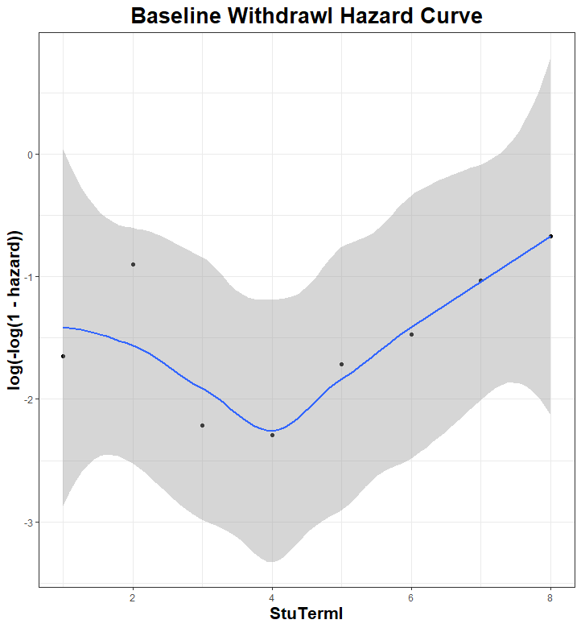
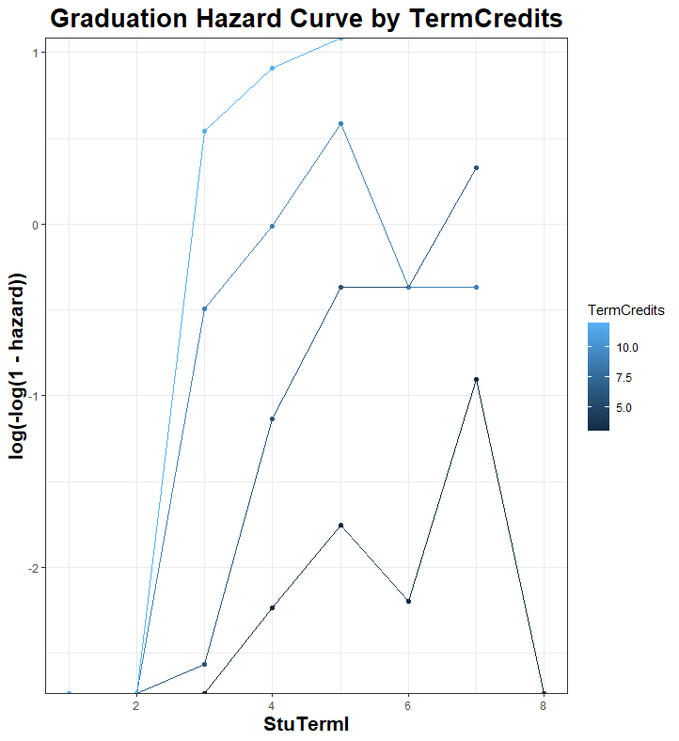
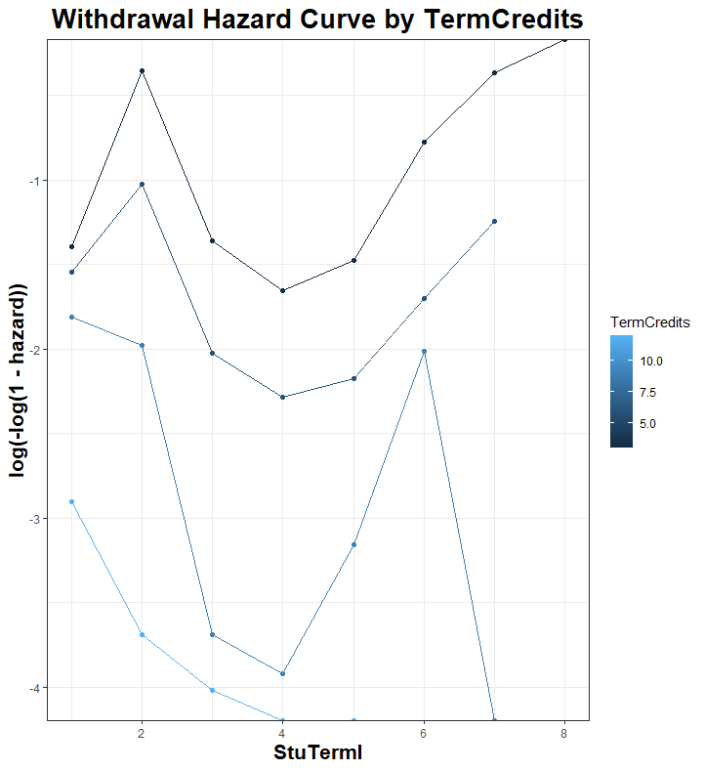
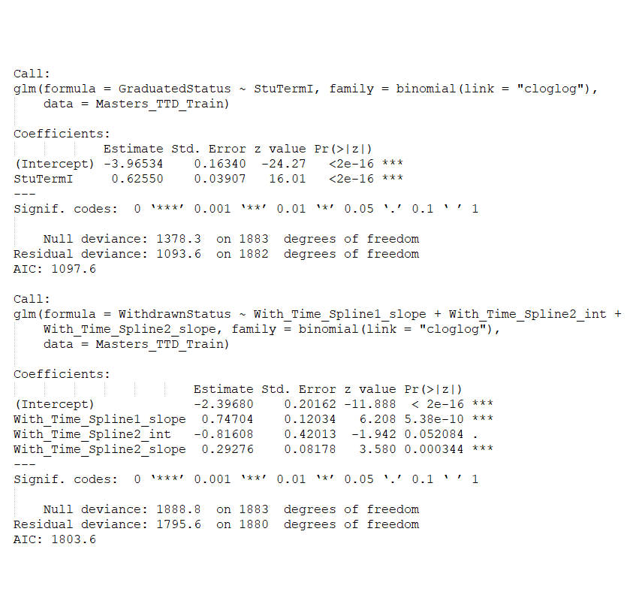
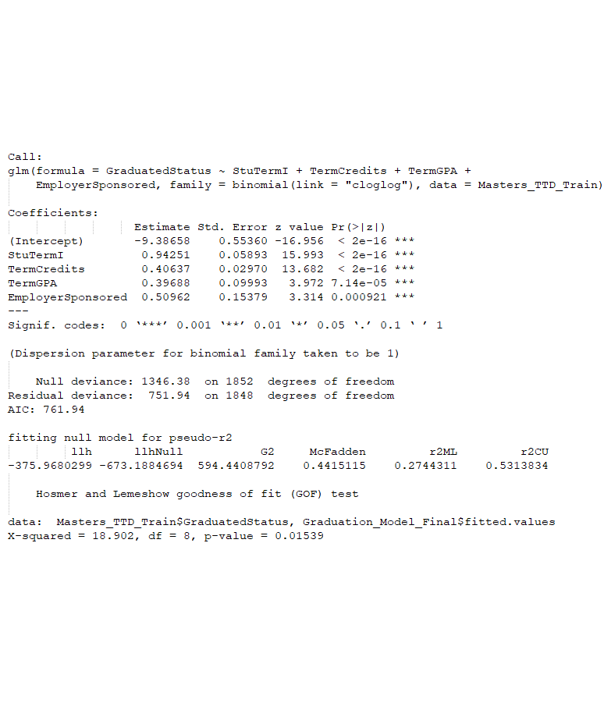
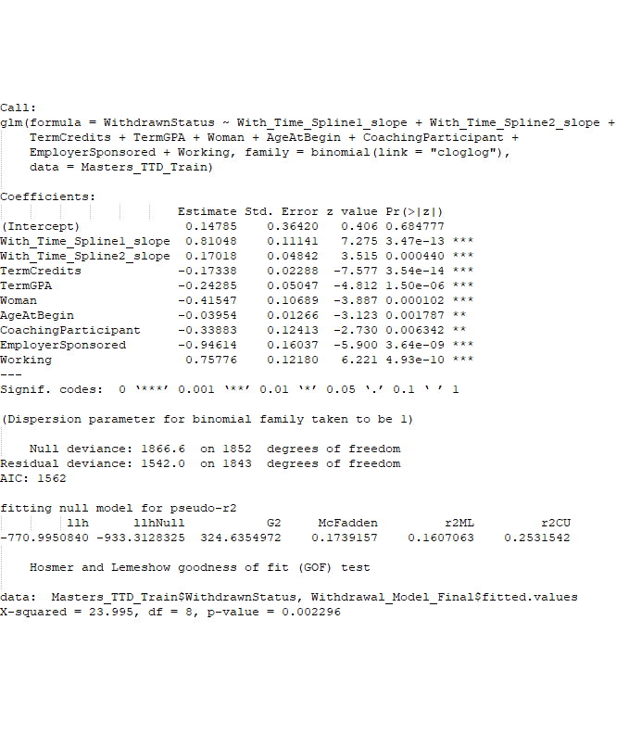
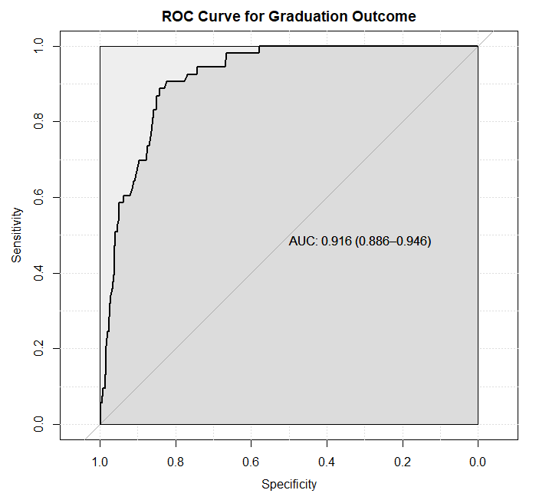
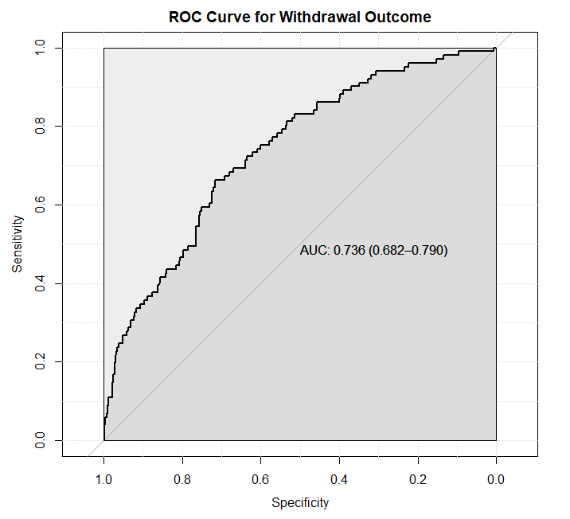


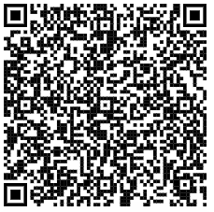
Follow along on this adventure of examining degree retention and completion at for a set of master's students at Survivor University using the code and resources available on our GitHub using the QR code to the right. If you get lost along the way or have questions about how to use survival analysis on your students, please contact Angela using the QR code in the lower left corner of this poster. Bon voyage!
USING
SURVIVAL ANALYSIS
TO MODEL STUDENT SUCCEESS OVER TIME
2b. Review baseline hazard curves for linearity
1a. Check that there is no missing data and that the range and distribution of each variable is reasonable
2a. Split data into 80% training and 20% testing datasets
1b. Check the correlations between the independent and dependent variables
2f. Check for proportional hazards assumption between independent variables and outcomes
2c. Create one set of splines for each outcome so that the proportional hazards assumption holds for each spline
3a. Build final model using experience, theory, and significance to guide variable selection
2e. Check for linearity between "continuous" variables and the probability of the outcomes using the Hosmer Lemishow test
2d. Run Gompertz regression for each outcome to get baseline hazard curves
3b. Test model fit on training data
3b. Test model fit on testing data
X
Angela Rockwell, PhD
angela.rockwell@unco.edu
University of Northern Colorado
Office of Institutional Research and Effectiveness

